Slide 1
Leader: We are here together
ALL: May we ‘GO FOR GOLD!’ in our words and actions today!
Notes:
Slide 1: Gathering words
Leader: We are here together
ALL: May we ‘GO FOR GOLD!’ in our words and actions today!

Slide 2
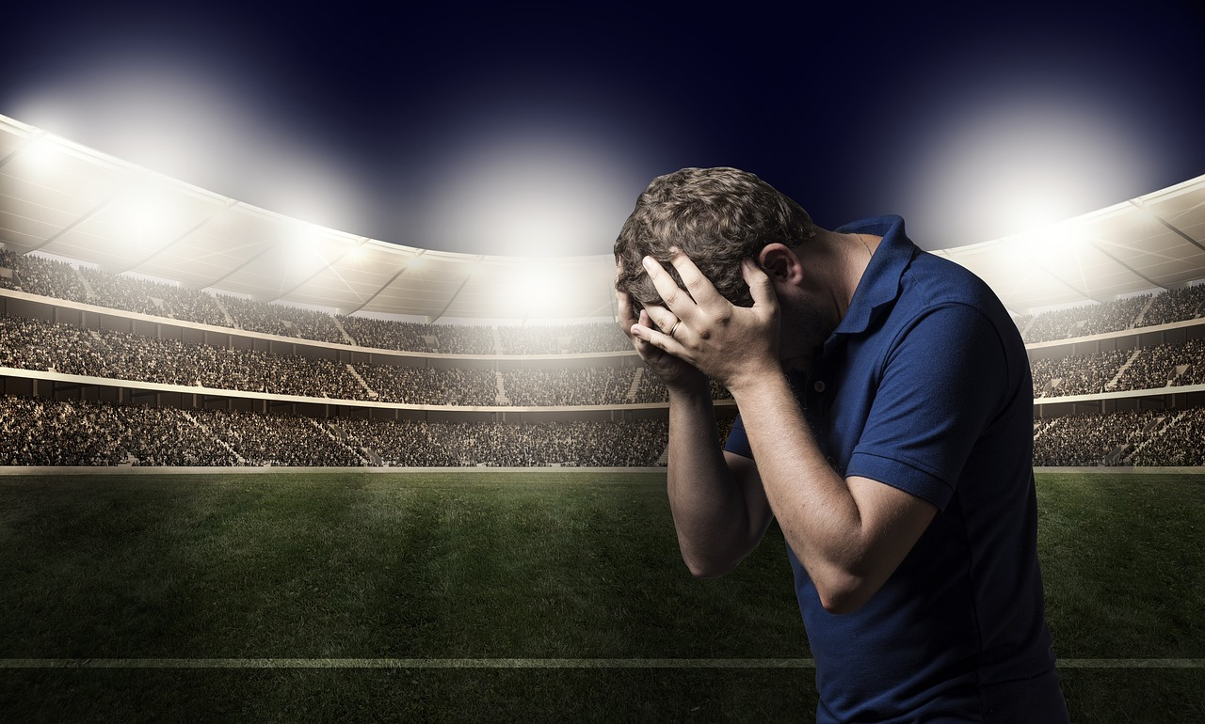
‘I give up!’
Notes:
Slide 2: I wonder if any of you have ever said these words, ‘I give up!’? I said ‘I give up!’ recently when…… [share a personal story to help break the ice!]
There’s nothing wrong with feeling like giving up – it’s a very human thing to feel! You may have noticed the words ‘when the going gets tough, the tough get going’ in the song that was playing as you were coming in / there’s a phrase that people use sometimes that goes like this:

Slide 3
‘…when the going gets tough, the tough get going…’

Slide 4
The Olympics
Respect
Friendship
Excellence
Determination
Equality
Determination
Courage
Inspiration
Inspiration
Olympic rings © Pixabay
Notes:
Slide 4: Given the question I’ve just asked, I wonder which Olympic value you think we’re going to think about today?!! You’re right….it’s determination! During our time together this morning, we’re going to think about giving up…..and the opposite – persevering…..keeping on going, showing the Olympic value of determination. During the Olympics this summer, you’ll be seeing plenty of athletes persevering, being determined…. but we’ll also reflect on what inspired him to keep on going, as we’ll hear later.

Slide 5
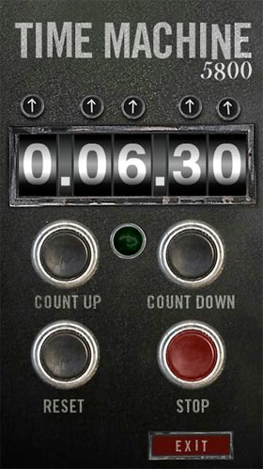
2024
CE
1964
CE
Notes:
Slide 5: and we’re going to travel back in our Olympic time machine to hear about one 10,000m runner in the 1964 summer Olympics, and what kept him from giving up……

Slide 6
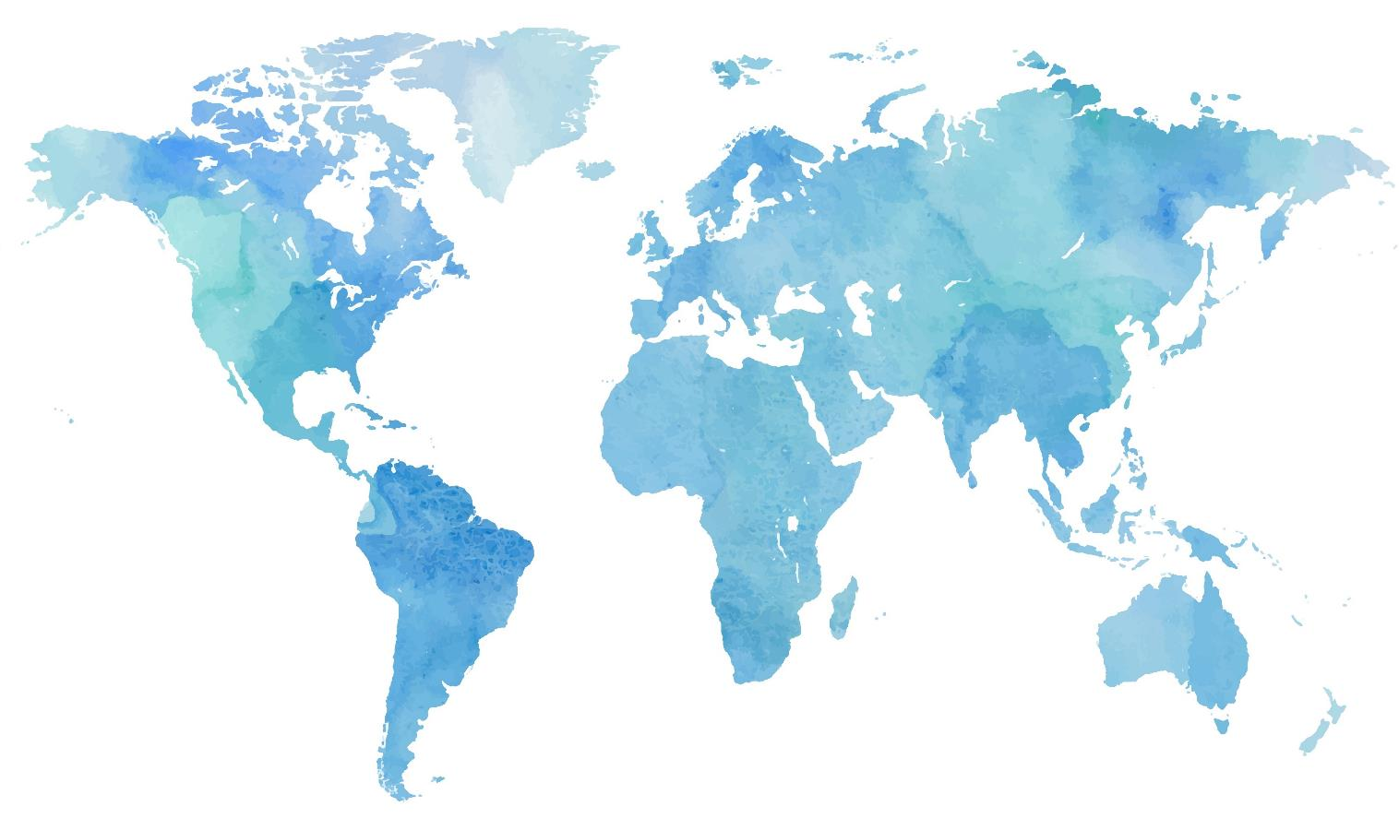
Notes:
Slide 6: In 1964, the Olympics took place in Japan.

Slide 7
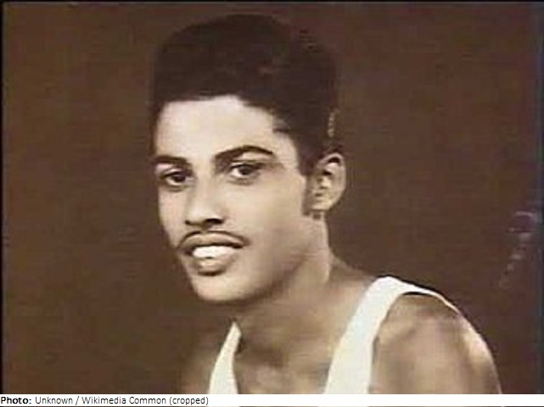
Notes:
Slide 7: This is a not-very-well-known athlete from Sri Lanka, called Ranatunga Karunananda. He, like many athletes from smaller countries, was more interested in taking part than winning.

Slide 8
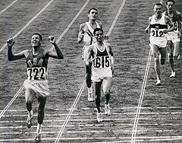
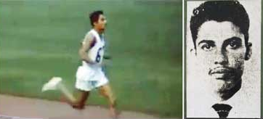
Ranatunga Karunananda – 10,000m (1964)

Slide 9
I saw you on television running all alone and I couldn't keep back my tears… I felt I was feeling for the first time the true Olympic spirit.
Notes:
Slide 9: After the event, Kurananada became a bit of a hero – especially in Japanese newspapers, and was sent thousands of letters and small gifts which Japanese fans usually send to their heroes. The Olympic Village office asked him to come down and collect his mail because the sack was too big for them to deliver! A young woman wrote these words in a letter to him: "I saw you on television running all alone and I couldn't keep back my tears…I felt I was feeling for the first time the true Olympic spirit.”

Slide 10
Participating is more important than winning.
Notes:
Slide 10: When Ranatunga Karunananda was asked about how and why he kept going, he recalled how he had promised his little daughter back home in Sri Lanka that no matter what, he would finish the race. He also said something that we’ve heard several times before: "Participating is more important than winning.”

Slide 11
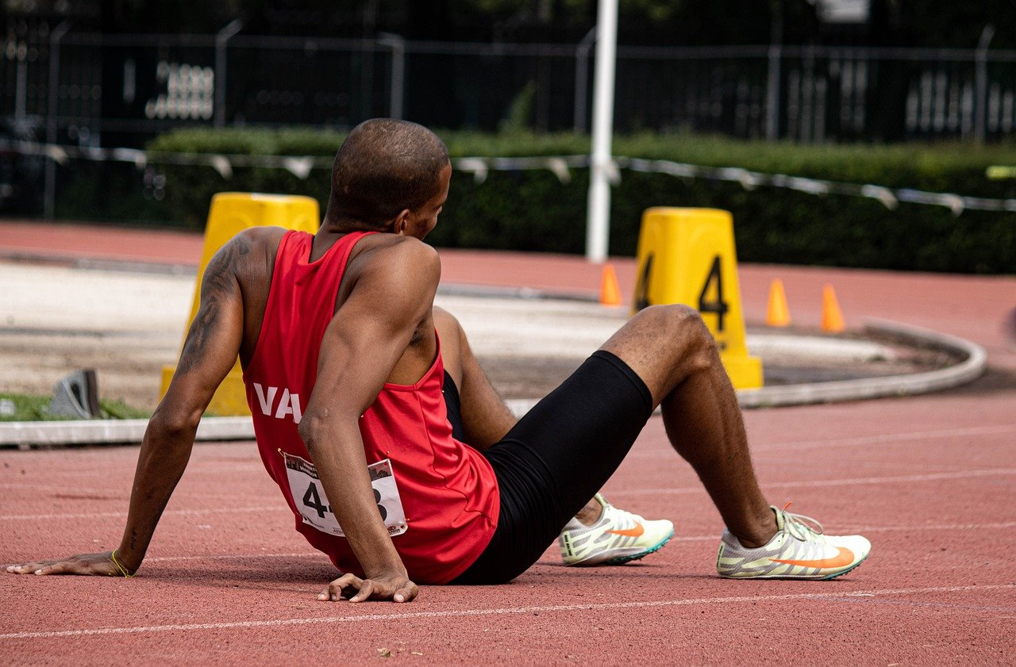
They remember……
They fix their eyes on the ‘goal’
Notes:
Slide 11: So, what can we learn from this event that might help us when we feel like giving up? Well, here are two things that many athletes do when they’re finding it hard to keep going:
They remember…… - they will remember the words of their trainer, just as you remind yourselves of your teachers’ words of advice as you do your work….or Ranatunga Karunananda remembered the promise he made to his daughter….
They fix their eyes on the ‘goal’ – so they might imagine themselves finishing their race…..or getting a medal: they fix their eyes on their goal, finishing the race, not on how they are feeling at that moment in time.

Slide 12
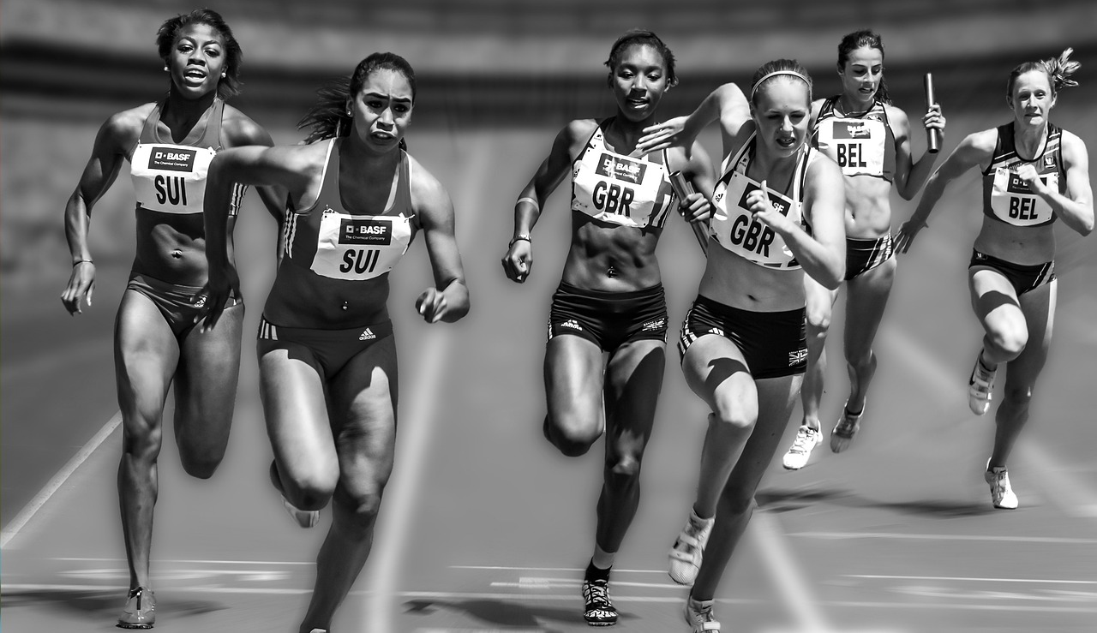
‘….run with perseverance the race marked out for you, fixing your eyes
on……
Jesus….’
Notes:
Slide 12: In the Bible, there are some words about a very different kind of race. They were written by a teacher named Paul, who gave good advice to Christians who were going through difficult times, not on a running track, but in their lives. Here’s the first part: ‘…run with perseverance the race marked out for you, fixing your eyes on……’
Can you think what Paul might have suggested next? [ask for some ideas] Here’s what Paul said: ‘…..Jesus, who has already finished the race.’ Just to be clear again, Jesus was not actually running in a race, but Paul was using the idea of running as a metaphor for people living life, even when things are hard.
When people who are Christians go through hard times, they will often remember how Jesus kept on going, even to his death, and how he finished the ‘race’ that Christians believe ends in heaven. Just as Karunananda fixed his eyes on his daughter when he ran his Olympic 10,000m, Christians will try to keep their eyes focussed on Jesus as they run the ‘race’ of their own lives.

Slide 13
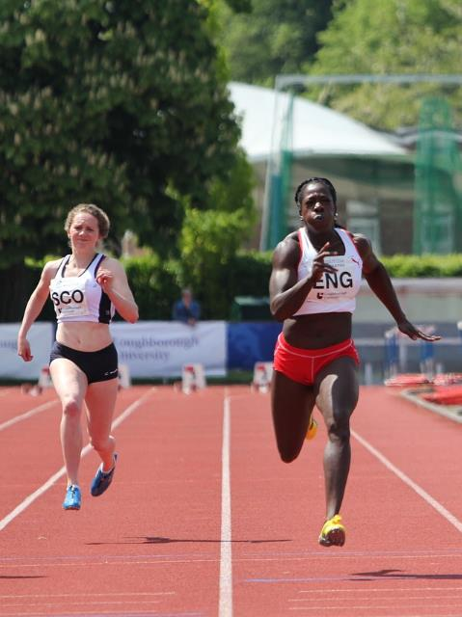
….I wonder what we can learn from their example?...
…I wonder what helps you to keep on going?....
….and who the people are who encourage you?…..
Notes:
Slide 14: Responding and words for worship
Let’s be quiet and still with our own thoughts now…..
….we’ve been thinking about how Ranatunga Karunananda kept on going by remembering the promise he’d made to his daughter…..
….and how people who are Christians keep on going by remembering how Jesus lived his life…..
….we can learn from their example…..
….I wonder what we can learn from their example?...
…I wonder what helps you to keep on going?....
….and who the people are who encourage you?…..
…...maybe your teachers …..your family….. your friends…..

Slide 14
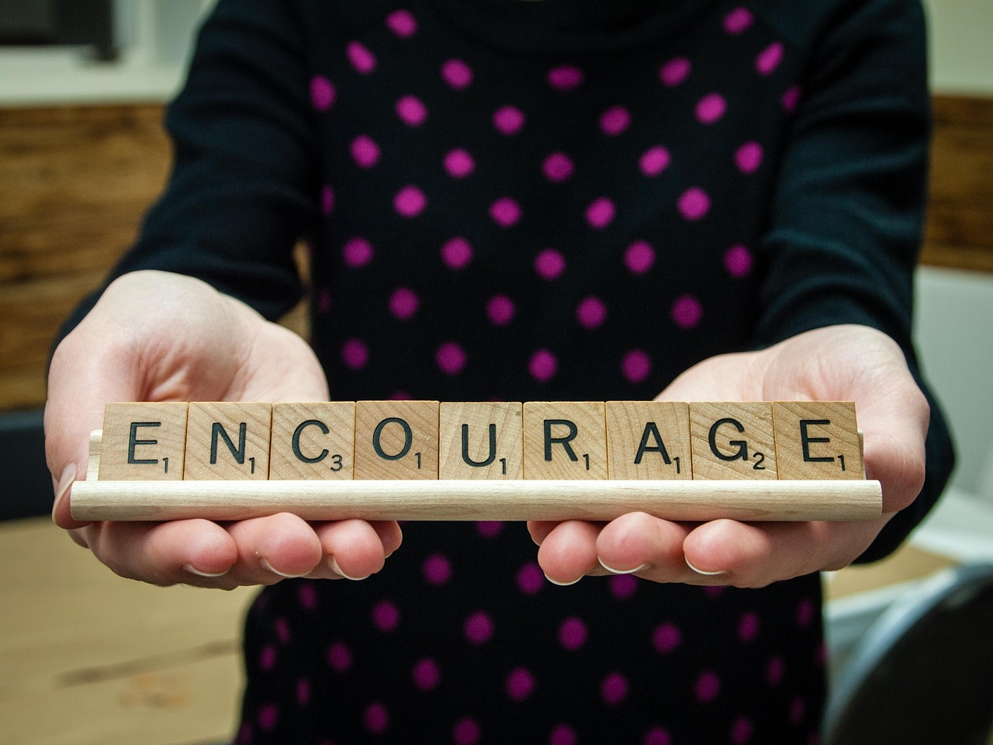
Dear God
Thank you for all the things we can learn through the more difficult experiences of our lives – when the going gets tough. Thank you for all those people who encourage and support us when we need help. Thank you that you promise to help us too.
Notes:
Slide 14:
Dear God
Thank you for all the things we can learn through the more difficult experiences of our lives – when the going gets tough. Thank you for all those people who encourage and support us when we need help. Thank you that you promise to help us too.

Slide 15
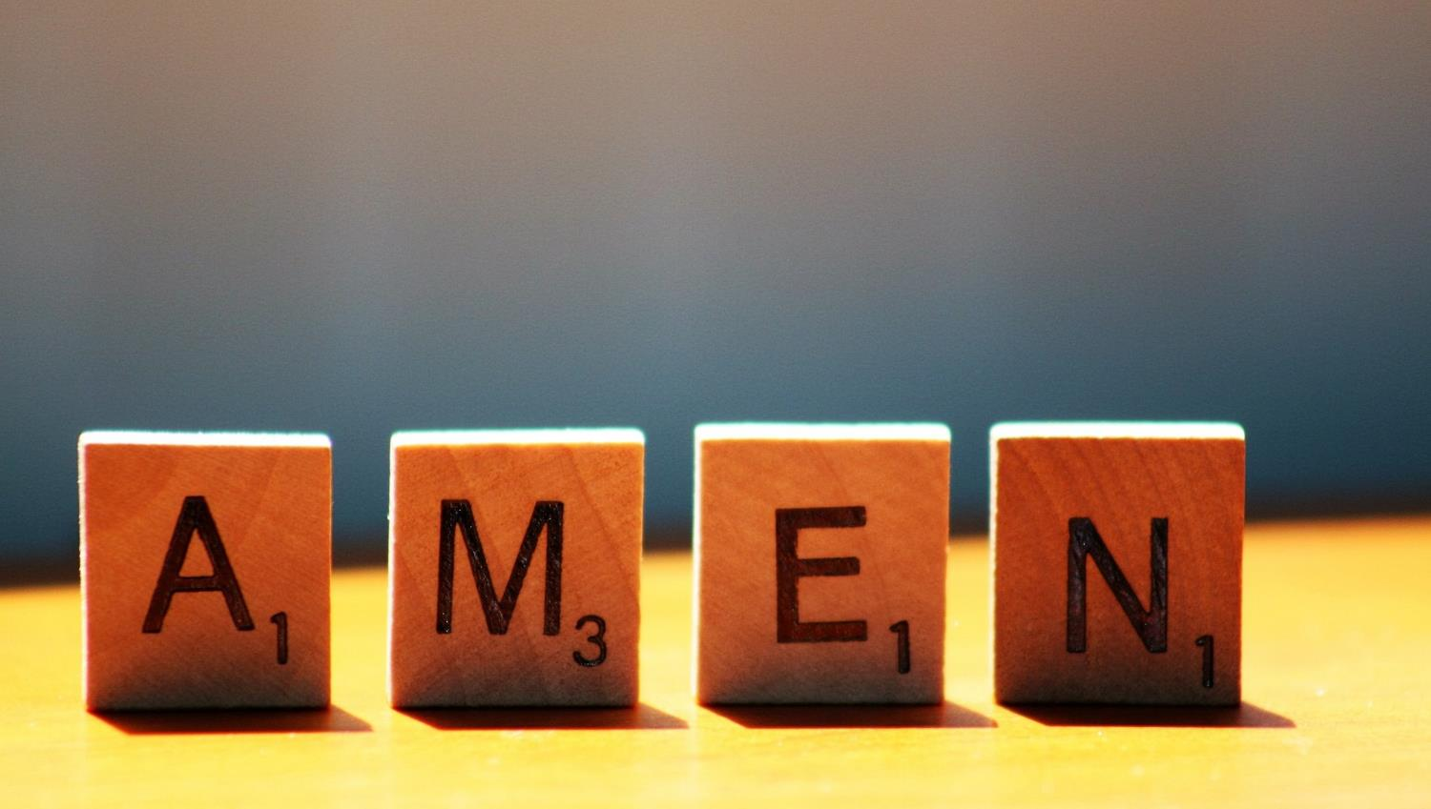

Slide 16
Leader: As we leave this place & time and go into the day ahead…
All: Let’s ‘go for gold’ in all that we do!
Notes:
Sending: Slide 16
Leader: As we leave this place & time and go into the day ahead…
All: Let’s go for gold* in all that we do!
*Again, you might need to unpick what we mean by ‘going for gold’ in the context of today’s words.

Slide 17
Notes:
Slide 17: Reflective areas: get practical!
Be an encourager this week! Encourage someone in your family / friendship group: help each other to think of encouraging words to say to help others to keep on going.

